Slide 1
Intro to Argument
P. Flores

Slide 2
Argument:
Using reasoning to arrive at (a version of) truth

Slide 3
Plato
Truth is knowable
Truth is perfection
Truth is God
The way to know God is to search for truth.
We may never get to truth (God)

Slide 4
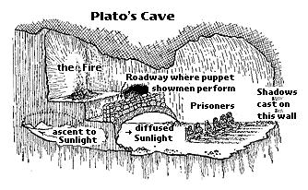
Allegory of Cave

Slide 5
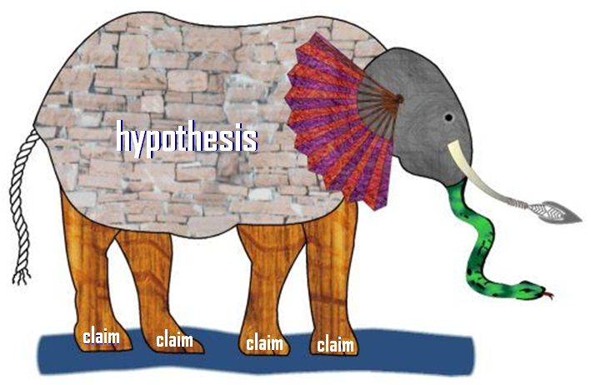
Analogy of the Elephant

Slide 6
Structure of Argument
Hypothesis or proposition
Claim
Evidence to support claim (see rules of evidence)
Refutation of claim (counter claim)
Rebuttal (attack counter claim)
Conclusion
Call to action. Tell reader what to think (logos), feel (pathos), believe (ethos), or do (action).

Slide 7
Rules of Evidence
Real
Recent
Relevant
Repeatable

Slide 8
Sample thesis
Simplest form:
Franklin is _(right/wrong)_ because _(reason)_
opinion

